Slide 1

Library Management System
M. Ayub Khan
Abdul mouiz
Emaan Hassan
Rida Fatima

Slide 2

Introduction
Objective:
The purpose of the program is to aid library administration to automate the library management system.
Features:
Add books.
Issue books.
Return books.
Find books.

Slide 3
Basic go through of the code
Input:
Book name.
Author name.
Shelf number.
Price.
Process:
Takes the input from the user and stores it in various arrays. It also displays the books, issue the books and returns the books upon the user’s intended request.
Output:
Displays all the books’ details or certain books’ details using corresponding book IDs and issues or returns books.

Slide 4
Functions used
addBook()
Adds a new book to the library.
displayBooks()
Displays list of all the books in the library.
searchBookByID()
It searches for a book using its corresponding ID.

Slide 5
Functions used (Continued)
IssueBook()
It issues a book to the user and marks it as issued.
returnBook()
It marks an issued book as returned.
searchBookByShelf()
It lists all the books stored on a specific shelf.

Slide 6
Viewing the functions one by one

Slide 7
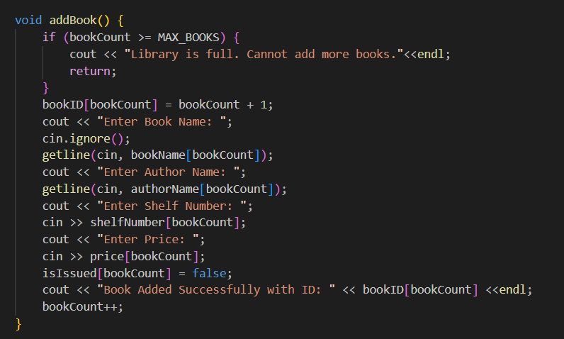
addBook()
This function allows users to add new books to the library by entering details like the book's name, author, shelf number, and price. Each book is assigned a unique ID automatically, and the system ensures the library doesn’t exceed its maximum capacity.

Slide 8
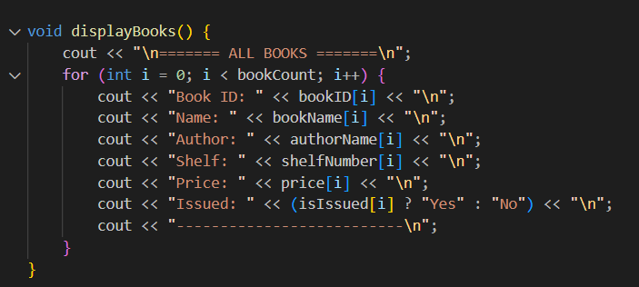
displayBooks()
This function lists all the books in the library along with their details, such as ID, name, author, shelf number, price, and whether the book is issued. If no books are available, it displays an appropriate message.

Slide 9
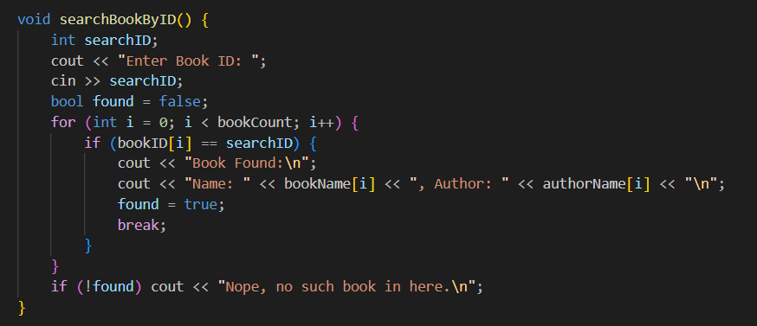
searchBookByID()
This function searches for a specific book using its unique ID. If the book is found, it displays its details, such as the name and author. Otherwise, it informs the user that the book is not in the system.

Slide 10
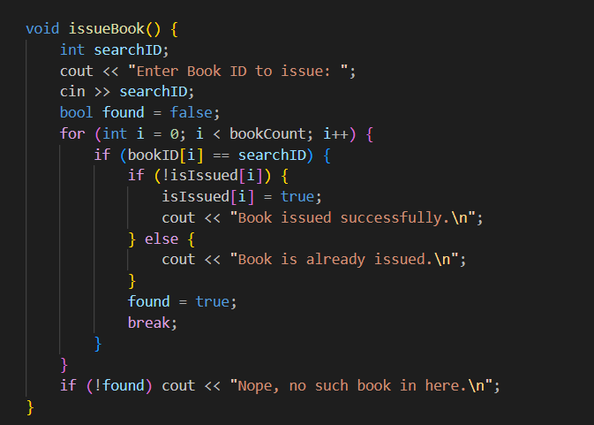
issueBook()
This function allows users to issue a book by marking it as "issued." It ensures the book is available before issuing and prevents issuing the same book multiple times.

Slide 11
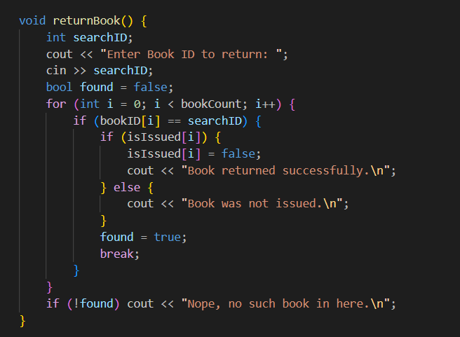
returnBook()
This function enables users to return an issued book. It ensures the book was previously issued and updates its status accordingly, providing feedback for both successful and unsuccessful return attempts.

Slide 12
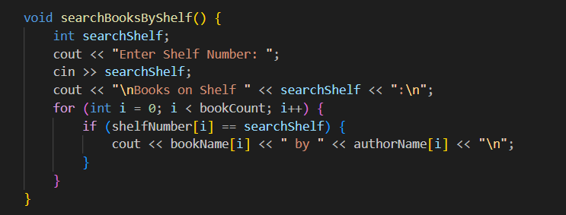
searchBookByShelf()
This function searches for all books located on a specific shelf. It displays the names and authors of the books on the shelf or informs the user if the shelf is empty.

Slide 13
Int main function
The int main() function serves as the central control hub of the library management system. It displays a menu of options, such as adding books, displaying books, searching, issuing, and returning books. Based on user input, it calls the appropriate function to perform the selected task. The program runs in a loop, allowing multiple operations until the user chooses to exit.

Slide 14

conclusion
The Library Management System is a simple yet effective program that automates key library operations, including adding, displaying, searching, issuing, and returning books. With a user-friendly menu and structured functionality, it ensures efficient management of library resources.

Slide 15

THANK YOU

